Slide 1

Chesterfield Data Centers

Slide 2
BREAKING THE STONEWALL - GOOGLE’S COUNTY UTILITIES
How many MGD (million gallons per day) has the County committed to the 11 Google datas?
8 MGD Peanut 3 data’s. According to Senior Staff source, when Google bought the property, Casey signed agreement for 6 MGD without consulting then Utility Director George Hayes. After BOS passed case in June 2025 Casey agreed to 2 MGD more. Verified with Bermuda Supervisor Jim Ingle. Cross checked need for 8 MGD against same size Google data’s in Botetourt County VA. A lawsuit there resulted in Google revealing water usage of 2-8 MGD.
2,160,920 MGD Loch 5 data’s. From FOIA agreement with County and Google
(890 acres X 2428 gallons per acre)
1,495,500 MGD Skyward 3 data’s. From FOIA agreement with County and Google
(750 acres X 1994 gallons per acre)
11,656,420 MGD Total committed by County to Google
39.5 MGD Average MGD per day for Chesterfield County
29.5% Percent Google usage adds to County daily average

Slide 3
110 MGD Chesterfield County current total capacity.
10.6% Percent of Google’s committed usage of total County capacity.
51,156,420 MGD TOTAL of Google 11,656,920 MGD daily usage added to the County current daily average usage of 39.5 MGD.
46.5% Percent 51,156,420 to County 110 MGD total capacity.
In March 2026 a Senior Staff source said the new Utility Director (well respected former Director George Hayes had retired in Dec 2025) approached him regarding Google’s request for additional County water. I asked Bermuda Supervisor Jim Ingle if the BOS would give Google additional County water. He emphatically stated NO. He further stated County negotiated insufficient water for Loch and Skyward to force them to build the purple line carrying treated water at Proctors Creek Plant to the Peanut site thereby reducing usage of clean county water. Per the FOIA Effluent Quality and Conveyance redacted agreement between the County and Google, Google will fund a $1.5M engineering study to determine feasibility of building a purple line to Peanut. Either party can cancel the study without penalty with proper notice. There is no legally binding requirement for Google to build the purple line!

Slide 4
HOW WILL GOOGLE DATAS IMPACT COUNTY WASTEWATER CAPACITY
11,656,420 MGD Clean water committed to Google 11 data’s.
2,331,284 MGD Wastewater generated by Google data’s using 20% bleed-off.
Bleed-off percent could vary from 10 to 30%. If the County approves additional clean water for Loch and Skyward, the wastewater bleed-off could increase.
17 MGD Average daily wastewater at Proctors Creek Plant. Peaks in the evening in the low 20s MGD.
13.7% Google wastewater percent being added to the 17 MGD average daily wastewater.
27 MGD Current wastewater capacity at the Proctors Creek Plant.
19,331,284 MGD Google wastewater of 2,331,284 added to plant’s average daily 17 MGD
.
72% Percent of 19,331,284 to the 27 MGD total capacity.
The evening peak in the low 20s MGD could increase this percent.

Slide 5
WILL COUNTY TAXPAYERS PAY COST OF GOOGLE’S
UTILITY UPGRADES?
CHRONOLOGICAL ANALYSIS
Mar 2020 With BOS approval EDA buys 307 acres of private property (secret code name Peanut) for $21.1M and sells to Peanut LLC (Google) for $18.1M same day.
Mar 2020 BOS passes on a consent agenda a 24 cent machinery and tool tax for the Peanut site without any discussion of an exact usage for the development of the property.
Aug 2022 Chesterfield finalizes the purchase of land on the Appomattox for a fourth water source.
Apr 2025 County announces plans for its fourth water source on the Appomattox in the 2025 General Fund budget for $426M. This additional source, to be completed in 2031, will add 20 million gallons to the County's 110 million gallon capacity.
June 2025 County announces sale of 2 large private properties in Western Chesterfield for commercial development with LLCs eventually traced to Google. Project Skyward 750 acres, Project Loch 890 acres.

Slide 6
Jun 27, 2025 With just days public notice, County BOS passes agreements with Google for Peanut, Skyward, and Loch. All three sites will get a 24 cent’s machinery and tool tax rate for 30 years. Per Jim Ingle conversation with Phil Lohr in Jan 2026, Google could build 3 data’s at Peanut, 3 at Skyward, and 5 at Loch.
Feb 2026 County announced plans to increase capacity at Proctors Creek wastewater plant by 12 million gallons with a large settling tank. The $168.3M cost is to be financed mostly by bonds sold by Utilities. Completion date is 2028. At the end of March during final budget briefings the new County Utility Director announced a large increase in citizens' water bills (14%) and wastewater bills (17%) effective 2027 to pay costs for increased capacity.
SUMMARY
With the timing of the dates and funding passed by BOS in April 2025 for expanded water sources ($426M) and the March 2026 expansion of the wastewater plant ($168.3M), it's obvious these actions were directly related to increased demands of the anticipated 11 Google data’s. The County had purchased the Appomattox site in 2022 but no specific date for construction or cost had been announced.

Slide 7
The $168.3M for a 12 million gallon expansion of the Proctors Creek wastewater plant is the first stage of expansion intended to double the wastewater capacity to 54 million gallons per day at a total cost of $689M. The initial expansion had already been discussed at least 10 years prior, but funding was dependent on future needs with no specific date announced publicly until the Google datas were approved.
The County’s wastewater and water expansions have been timed to eliminate the possibility that Google will have to pay for any of either expense. The wastewater is planned to be completed by 2028. Google's first data at Peanut is in the final site plan review anticipated by the County to be completed by April 22, 2026. Site plan notes Google could take 18-24 months to complete first data which would coincide with the wastewater expansion completion of 2028.
The Appomattox 20 million gallon per day water expansion is anticipated to be completed by 2031 which will coincide with Google's completion of the other 2 data’s at Peanut. The wording in the County agreement stated clearly that Google will be responsible for additional utility infrastructure
ONLY if the County does not have sufficient capacity at the TIME OF COMPLETION of each data center. County plans show that will not happen. Taxpayers likely pay for the entire cost! $168.3 + 426 = $594.3M dollars!

Slide 8

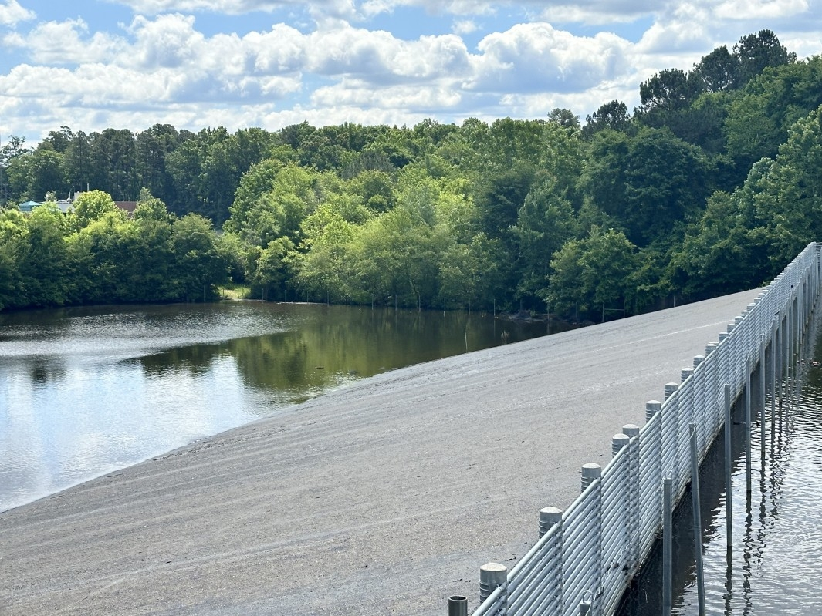

Slide 9
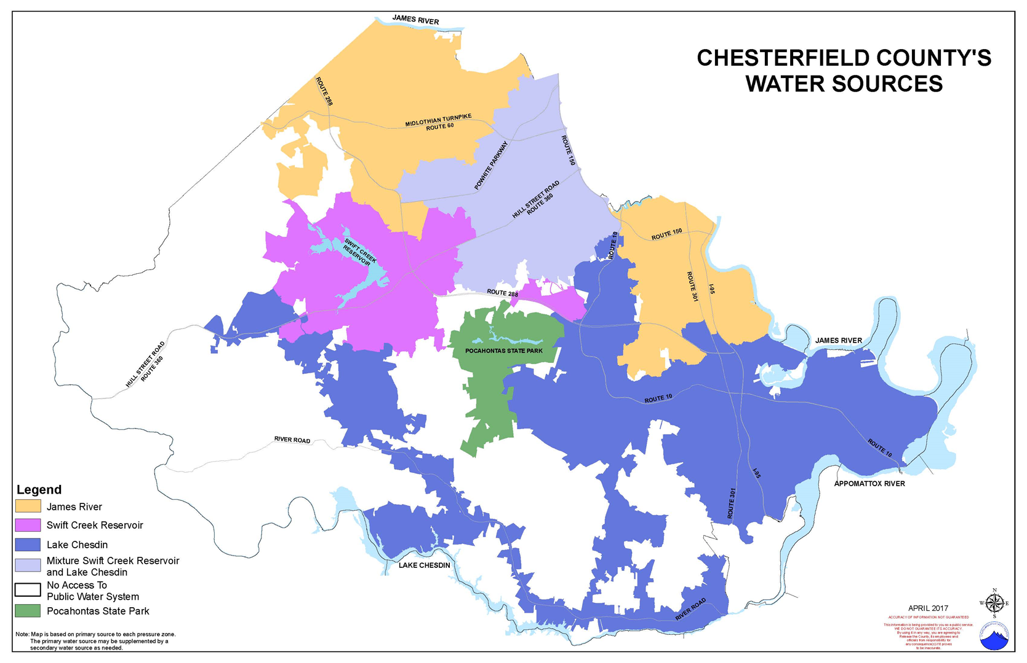

Slide 10
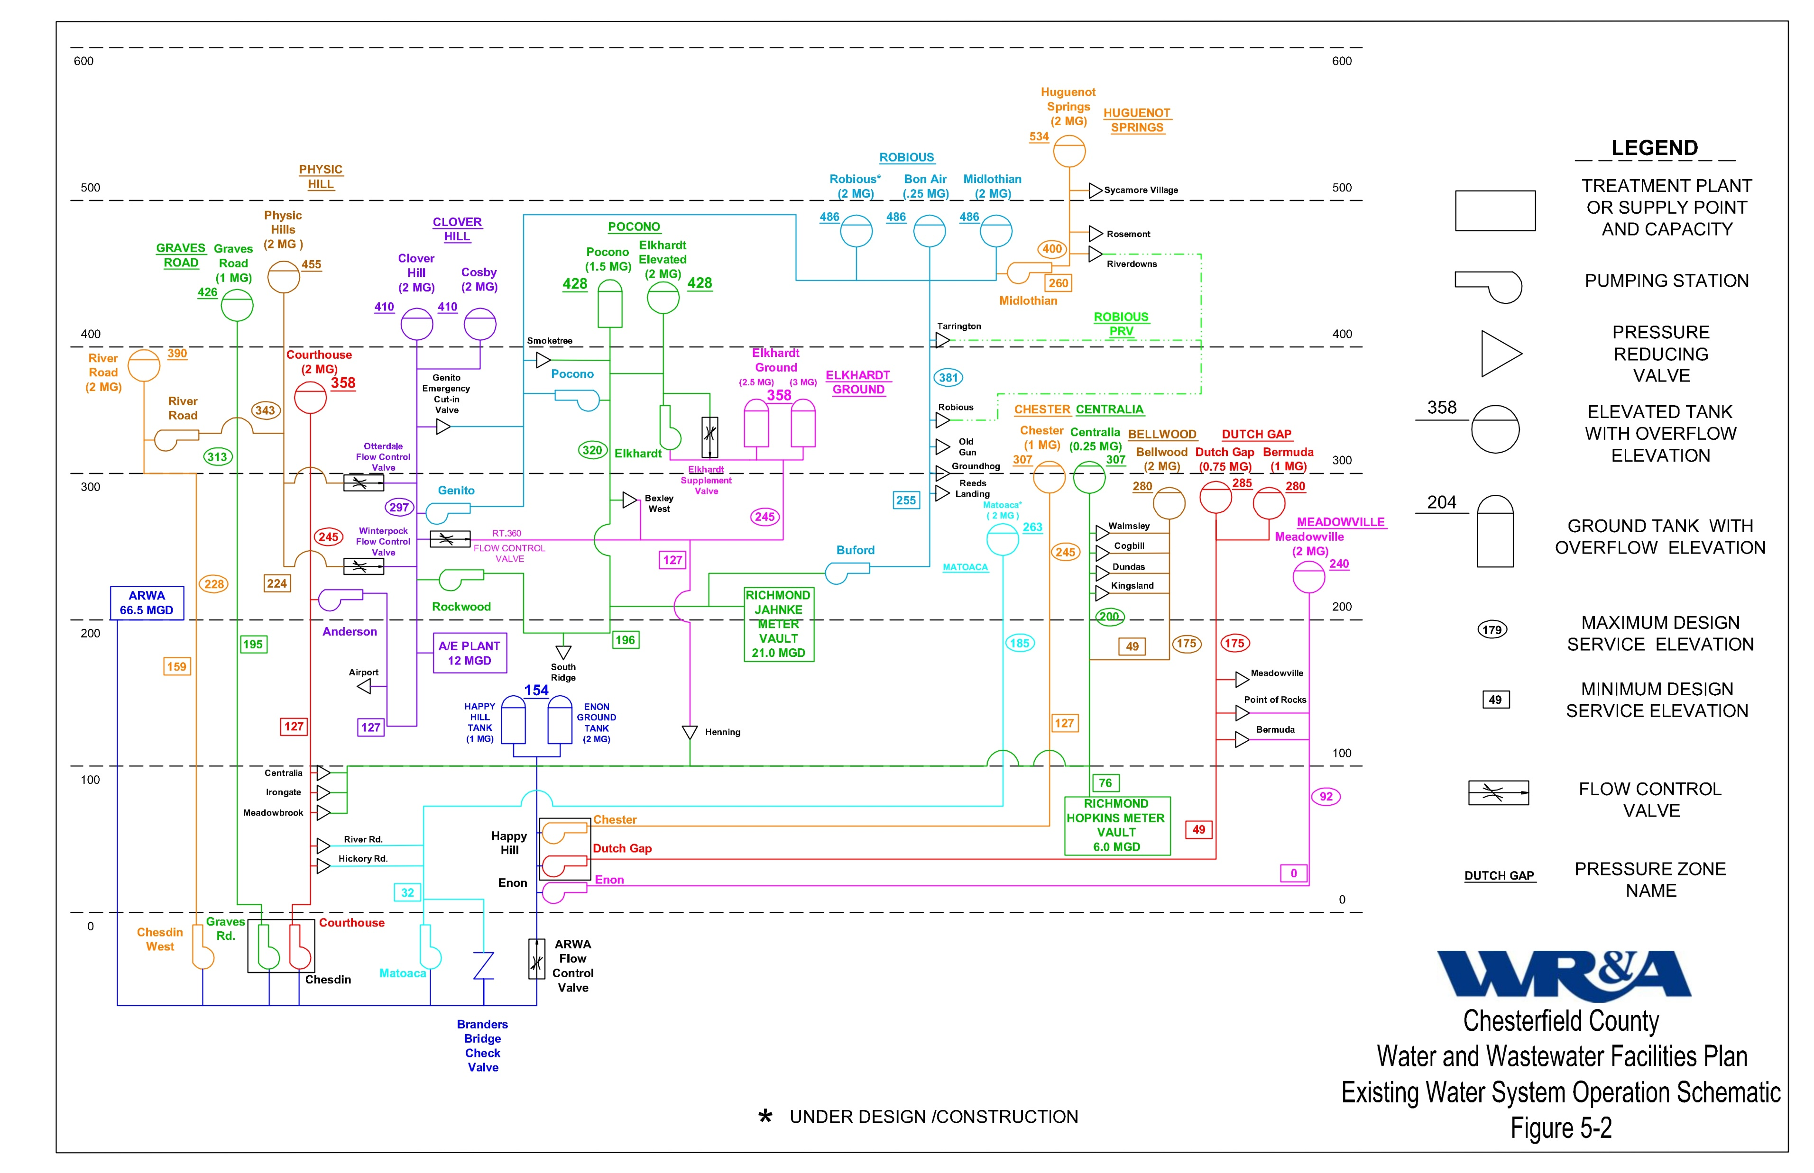

Slide 11
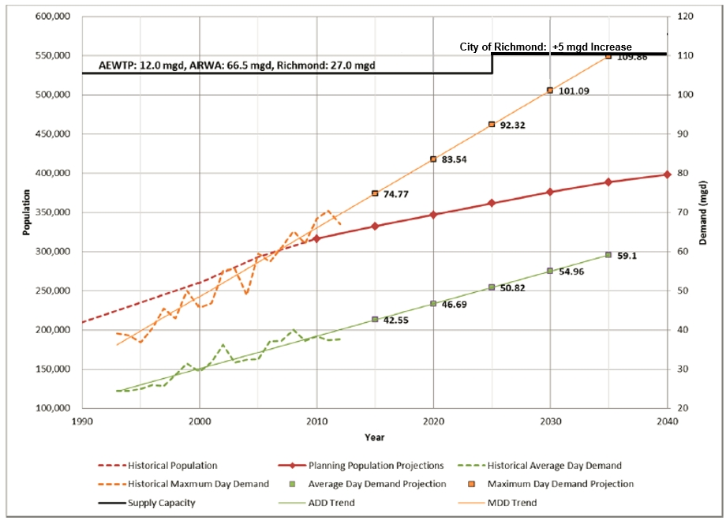
Water Report 2018

Slide 12
2020 |  | Jan-20 |  | Feb-20 |  | Mar-20 |  | Apr-20 |  | May-20 |  | Jun-20 |  | Jul-20 |  | Aug-20 |  | Sep-20 |  | Oct-20 |  | Nov-20 |  | Dec-20 |  | % of Total
Average Temprature |  | 43.2 |  | 45 |  | 54.8 |  | 56.9 |  | 63.8 |  | 75.3 |  | 82.9 |  | 79.2 |  | 69.7 |  | 62.3 |  | 54.6 |  | 41.3
ARWA (MG) |  | 16.038 |  | 15.047 |  | 16.315 |  | 17.874 |  | 19.167 |  | 25.623 |  | 30.306 |  | 25.334 |  | 30.916 |  | 28.068 |  | 23.453 |  | 21.785 |  | 64%
Richmond (MG) |  | 5.338 |  | 5.579 |  | 5.918 |  | 7.252 |  | 8.986 |  | 11.934 |  | 16.845 |  | 12.069 |  | 11.989 |  | 9.097 |  | 7.156 |  | 6.858 |  | 26%
A & E Plant (MG) |  | 6.448 |  | 6.919 |  | 7.189 |  | 6.697 |  | 8.651 |  | 7.782 |  | 9.713 |  | 4.106 |  | 0.000 |  | 0.000 |  | 0.000 |  | 0.000 |  | 14%
2021 |  | Jan-21 |  | Feb-21 |  | Mar-21 |  | Apr-21 |  | May-21 |  | Jun-21 |  | Jul-21 |  | Aug-21 |  | Sep-21 |  | Oct-21 |  | Nov-21 |  | Dec-21 |  | % of Total
Average Temprature |  | 39 |  | 38.6 |  | 51.3 |  | 58.9 |  | 65.9 |  | 76.1 |  | 79.5 |  | 79.9 |  | 72.6 |  | 65.9 |  | 47.7 |  | 48.9
ARWA (MG) |  | 21.720 |  | 21.200 |  | 21.837 |  | 21.809 |  | 29.292 |  | 31.292 |  | 29.949 |  | 26.911 |  | 26.599 |  | 26.557 |  | 18.063 |  | 21.986 |  | 66%
Richmond (MG) |  | 6.565 |  | 5.528 |  | 6.472 |  | 7.759 |  | 11.528 |  | 11.848 |  | 13.242 |  | 11.589 |  | 11.619 |  | 9.925 |  | 6.833 |  | 6.830 |  | 25%
A & E Plant (MG) |  | 0.000 |  | 0.000 |  | 0.000 |  | 3.306 |  | 7.179 |  | 7.278 |  | 7.683 |  | 7.769 |  | 8.328 |  | 7.688 |  | 7.357 |  | 0.000 |  | 13%
2022 |  | Jan-22 |  | Feb-22 |  | Mar-22 |  | Apr-22 |  | May-22 |  | Jun-22 |  | Jul-22 |  | Aug-22 |  | Sep-22 |  | Oct-22 |  | Nov-22 |  | Dec-22 |  | % of Total
Average Temprature |  | 36.5 |  | 44.5 |  | 52.4 |  | 59 |  | 68.5 |  | 75.5 |  | 80.7 |  | 78.5 |  | 72.8 |  | 57.7 |  | 53.1 |  | 40.6
ARWA (MG) |  | 22.158 |  | 16.221 |  | 16.296 |  | 19.318 |  | 21.802 |  | 28.774 |  | 29.171 |  | 27.230 |  | 32.769 |  | 30.045 |  | 22.899 |  | 20.129 |  | 62%
Richmond (MG) |  | 7.844 |  | 6.060 |  | 6.967 |  | 7.417 |  | 10.135 |  | 11.606 |  | 12.249 |  | 12.424 |  | 12.343 |  | 9.745 |  | 6.640 |  | 6.149 |  | 24%
A & E Plant (MG) |  | 0.134 |  | 5.612 |  | 6.455 |  | 6.861 |  | 8.586 |  | 8.491 |  | 9.578 |  | 9.448 |  | 7.867 |  | 4.171 |  | 4.611 |  | 4.486 |  | 17%

Slide 13
2023 |  | Jan-23 |  | Feb-23 |  | Mar-23 |  | Apr-23 |  | May-23 |  | Jun-23 |  | Jul-23 |  | Aug-23 |  | Sep-23 |  | Oct-23 |  | Nov-23 |  | Dec-23 |  | % of Total
Average Temprature |  | 46.2 |  | 48.8 |  | 50.9 |  | 61.8 |  | 64.8 |  | 72.3 |  | 81.2 |  | 78.9 |  | 73.2 |  | 62.9 |  | 49.4 |  | 45.6
ARWA (MG) |  | 19.300 |  | 18.686 |  | 18.789 |  | 23.218 |  | 24.961 |  | 26.789 |  | 27.122 |  | 29.352 |  | 27.901 |  | 27.802 |  | 21.911 |  | 20.108 |  | 64%
Richmond (MG) |  | 6.372 |  | 5.500 |  | 7.482 |  | 7.912 |  | 8.953 |  | 10.395 |  | 10.878 |  | 12.305 |  | 10.728 |  | 9.912 |  | 7.302 |  | 6.211 |  | 23%
A & E Plant (MG) |  | 4.506 |  | 3.755 |  | 3.789 |  | 3.915 |  | 6.515 |  | 7.717 |  | 8.449 |  | 8.689 |  | 7.619 |  | 5.519 |  | 4.797 |  | 3.435 |  | 16%
2024 |  | Jan-24 |  | Feb-24 |  | Mar-24 |  | Apr-24 |  | May-24 |  | Jun-24 |  | Jul-24 |  | Aug-24 |  | Sep-24 |  | Oct-24 |  | Nov-24 |  | Dec-24 |  | % of Total
Average Temprature |  | 41.6 |  | 44.9 |  | 53.4 |  | 61.1 |  | 70.1 |  | 78.8 |  | 80.9 |  | 78.3 |  | 72.3 |  | 62.4 |  | 54.7 |  | 42.4
ARWA (MG) |  | 19.554 |  | 19.160 |  | 21.313 |  | 27.326 |  | 22.889 |  | 35.012 |  | 30.593 |  | 28.145 |  | 24.538 |  | 26.840 |  | 21.660 |  | 23.983 |  | 64%
Richmond (MG) |  | 6.493 |  | 6.766 |  | 6.450 |  | 7.865 |  | 10.996 |  | 14.164 |  | 12.845 |  | 12.526 |  | 12.492 |  | 10.664 |  | 8.598 |  | 7.217 |  | 25%
A & E Plant (MG) |  | 3.998 |  | 3.192 |  | 2.399 |  | 0.008 |  | 6.658 |  | 7.805 |  | 9.069 |  | 9.998 |  | 9.639 |  | 8.393 |  | 6.739 |  | 0.000 |  | 14%
2025 |  | Jan-25 |  | Feb-25 |  | Mar-25 |  | Apr-25 |  | May-25 |  | Jun-25 |  | % of Total
Average Temprature |  | 33.5 |  | 41.4 |  | 53.2 |  | 61.5 |  | 67 |  | 78.1
ARWA (MG) |  | 23.289 |  | 17.960 |  | 21.981 |  | 19.434 |  | 22.714 |  | 25.709 |  | 60%
Richmond (MG) |  | 1.550 |  | 4.671 |  | 6.555 |  | 9.354 |  | 9.764 |  | 12.836 |  | 21%
A & E Plant (MG) |  | 7.099 |  | 7.458 |  | 3.312 |  | 8.769 |  | 9.338 |  | 10.928 |  | 22%

Slide 14
364,548
371,276
378,408
383,876
389,793
395,640
399,993

Slide 15
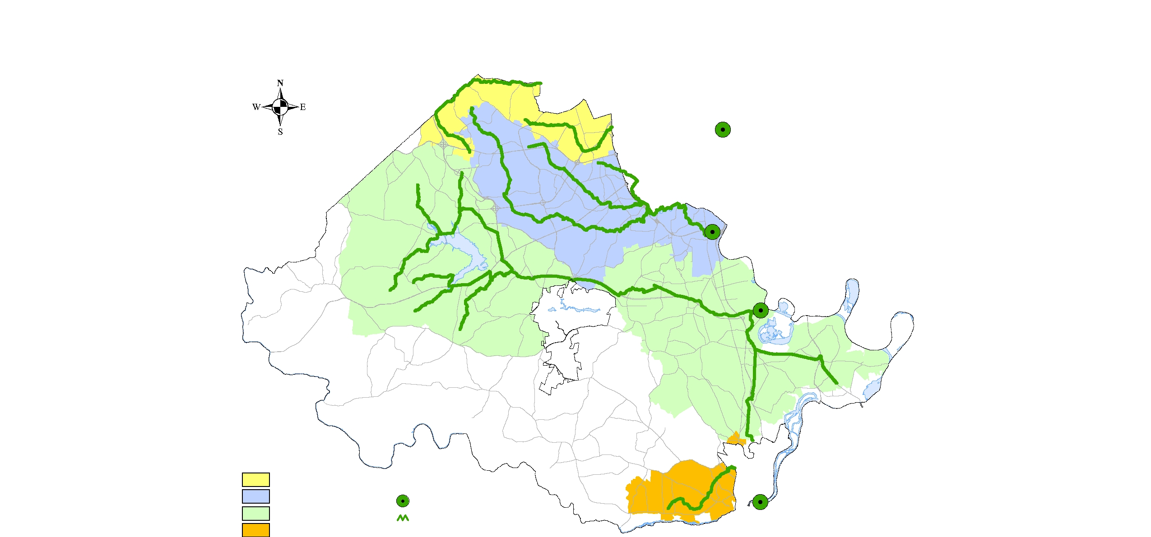
City of Richmond
Falling Creek Wastewater Plant
Capacity 12 MGD
Proctors Creek Wastewater Plant
Capacity 27 MGD
17 MGD Average daily wastewater at
Proctors Creek Plant. Peaks in the evening in the low 20’sMGD 0s MGD.
South Central Wastewater Plant
Capacity 2.3 MGD

Slide 16
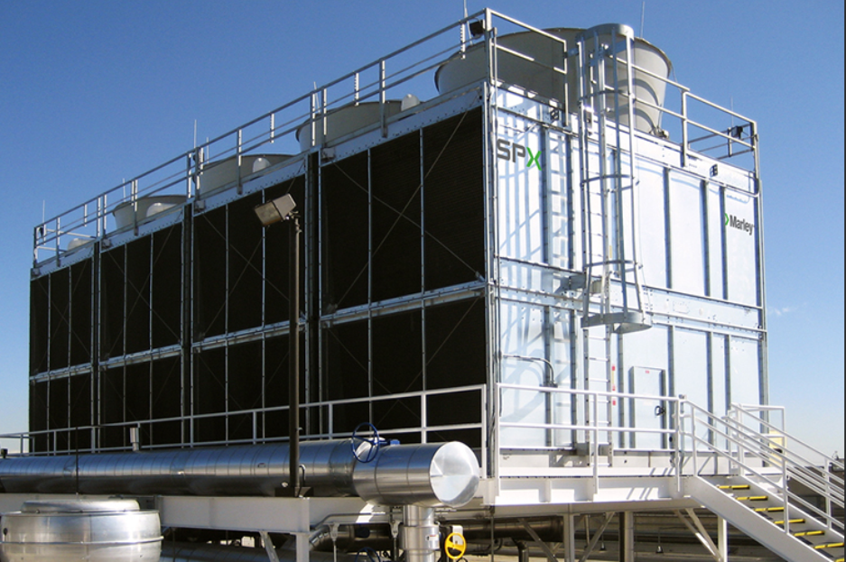
11,656,420 MGD Clean water committed to Google 11 data plants.
2,331,284 MGD Wastewater generated by Google datas using 20% bleed-off.

Slide 17
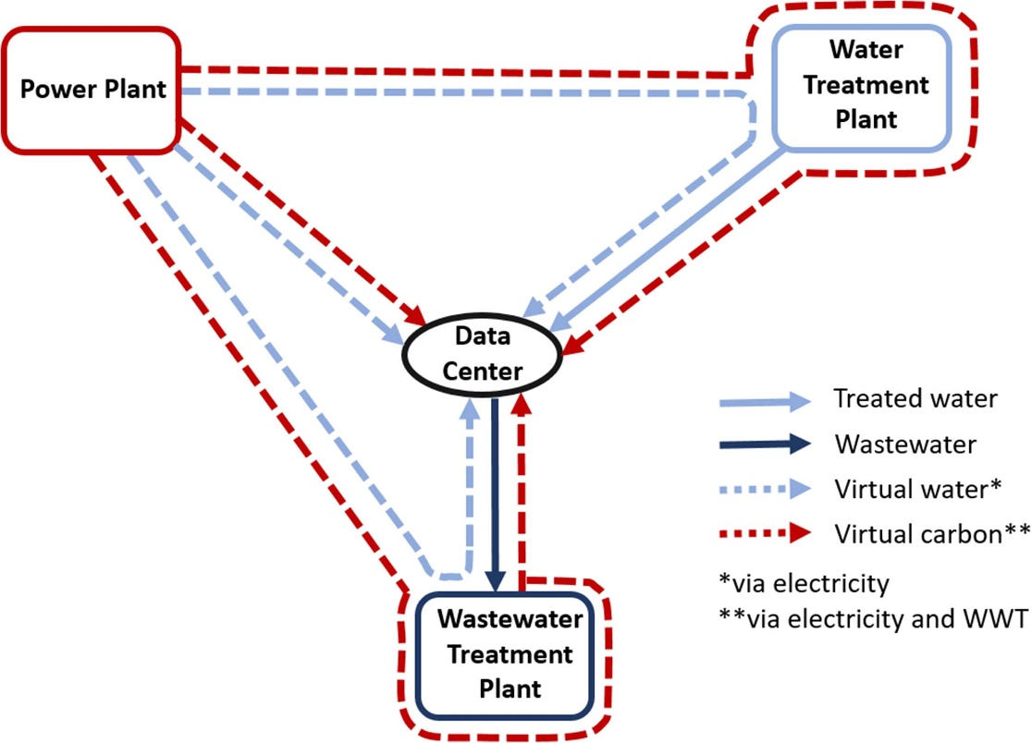
A data center’s water footprint is calculated as the sum of three categories: on-site water usage, water use by power plant facilities that supply power to data centers, and water consumption during the manufacturing process of processor chips.

Slide 18
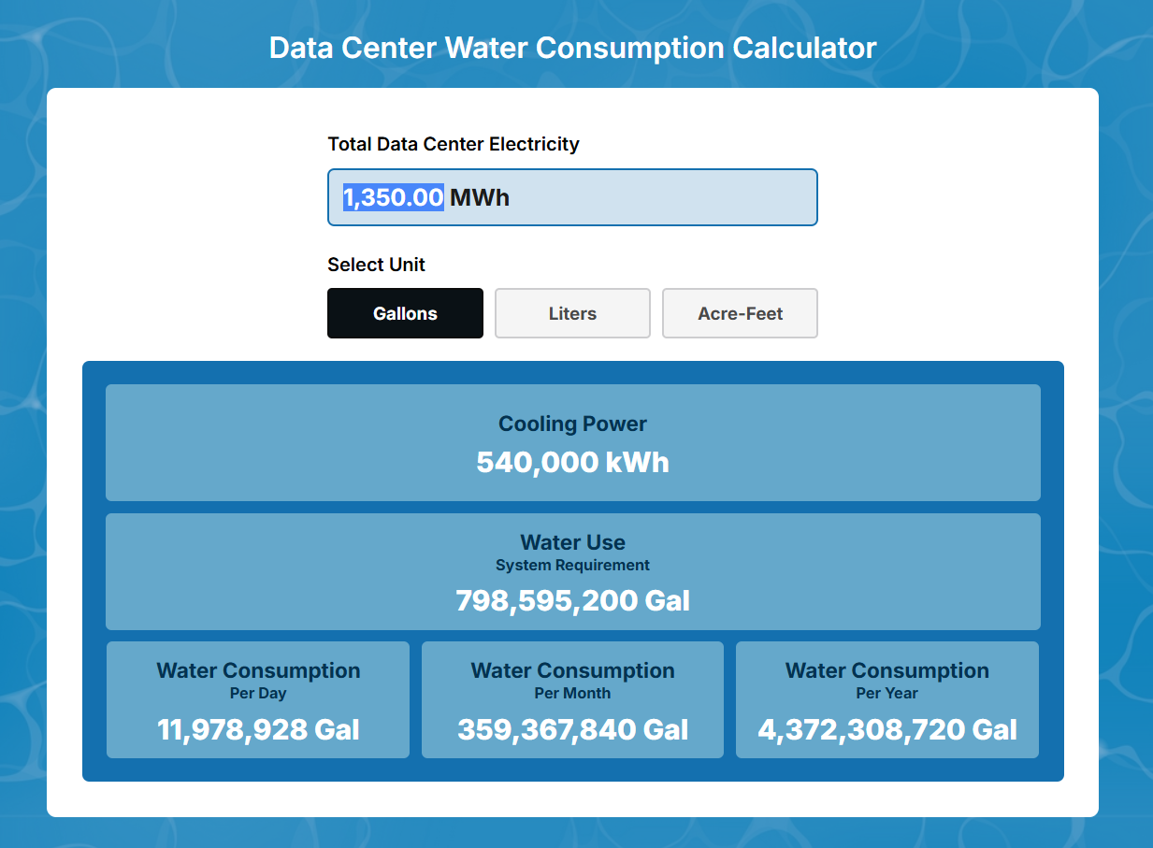
https://www.tapsrundry.com/data-center-water-consumption-calculator

Slide 19
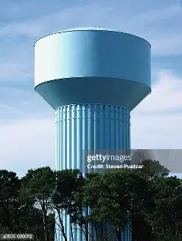
Pipe Size (inches) | Maximum Flow (GPM) | Velocity (ft/s) | Head Loss (ft/100 ft)
1/2″ | 4.5 | 7.0 | 11.5
3/4″ | 8.0 | 6.2 | 8.2
1″ | 14 | 6.3 | 6.4
1-1/4″ | 23 | 6.4 | 5.1
1-1/2″ | 35 | 6.8 | 4.6
2″ | 45 | 4.3 | 3.9
3″ | 130 | 5.6 | 3.9
4″ | 260 | 6.6 | 4.0
6″ | 800 | 8.9 | 4.0
8″ | 1600 | 10.3 | 3.8
10″ | 3000 | 12.2 | 4.0
2,000,000 /3700 flow from 16 inch pipe
Takes 22.5 hours to fill 2 Million gallon water tower

